Slide 1
BAI3020 Project Management Processes

Slide 2
Project Management Process Groups
A process is a series of actions directed toward a particular result
Project management can be viewed as a number of interlinked processes
The project management process groups include:
Initiating processes
Planning processes
Executing processes
Monitoring and controlling processes
Closing processes

Slide 3
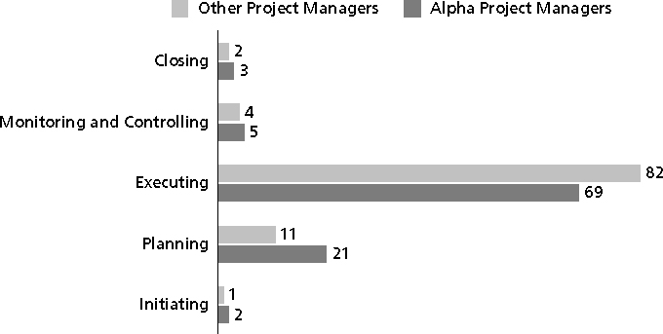
Percentage of Time Spent on Each Process Group
Alpha PM = top 2%

Slide 4
Media Snapshot
Just as information technology projects need to follow the project management process groups, so do other projects, such as the production of a movie.
Processes involved in making movies might include:
screenwriting (initiating)
producing (planning)
acting and directing (executing)
editing (monitoring and controlling),
releasing the movie to theaters (closing).
*Jacks, Brian, “Lord of the Rings: The Two Towers Extended Edition (New Line)”, Underground Online (accessed from www.ugo.com August 4, 2004).

Slide 5
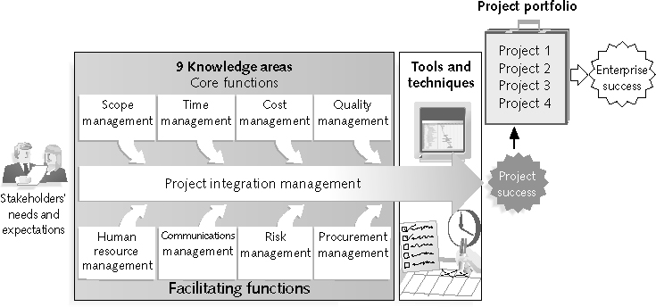
Mapping the Process Groups to the Knowledge Areas
You can map the main activities of each PM process group into the nine knowledge areas using the PMBOK® Guide 2008
Note that there are activities from each knowledge area under the planning and monitoring and controlling process groups

Slide 6
Project Management Framework

Slide 7
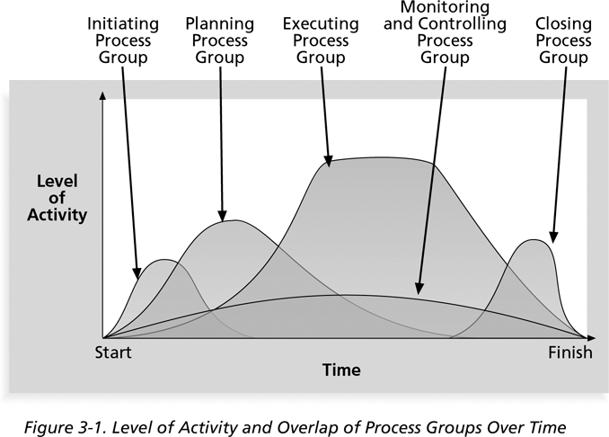
Process Group & Activity Level
See PMBOK 2008 Fig. 3.2 pg. 41

Slide 8
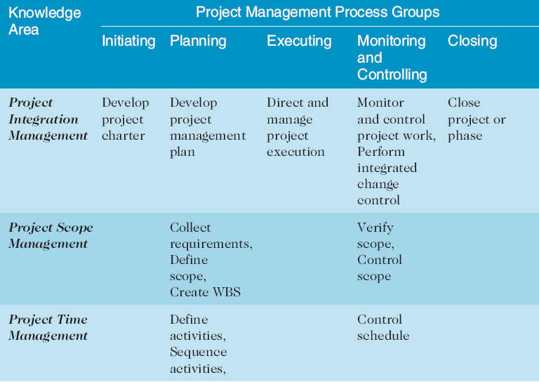
Project Management Process Groups and Knowledge Area Mapping*
*Source: PMBOK® Guide, Fourth Edition, 2008.

Slide 9
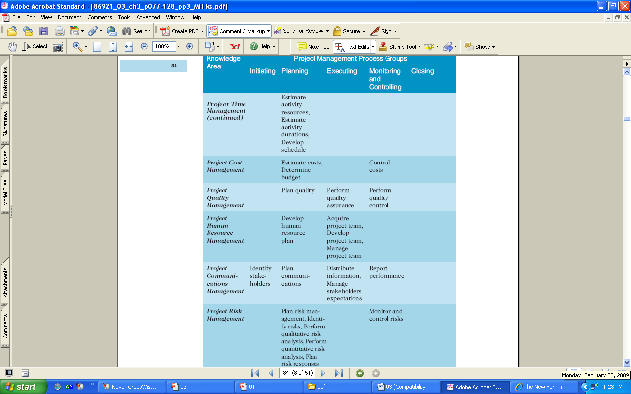
See PMBOK 2008 for details pg. 43

Slide 10
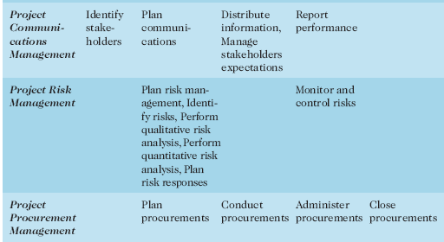
See PMBOK 2008 for details pg. 43

Slide 11
What Went Right example?
AgênciaClick, an interactive advertising and online communications company Brazil, made PMI’s list of outstanding organizations in project management in 2007
Since 2002, revenues jumped 132 percent, because of their five-year emphasis on practicing good project management
Creation of a daily custom tracking system alerting of any cost or time overruns
They used a process oriented approach

Slide 12
Project Pre-initiation
Senior managers often perform several pre-initiation tasks, including the following:
They determine the scope, time, and cost constraints for the project
Identify the project sponsor
Select the project manager
Developing a business case for a project Meet with the project manager to review the process and expectations for managing the project
Determine if the project should be divided into two or more smaller projects

Slide 13
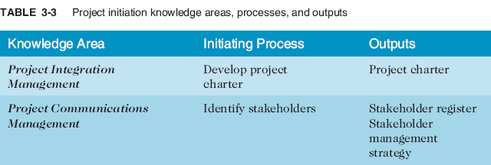
Project Initiation
Initiating a project includes recognizing and starting a new project or project phase
The main goal is to formally select and start off projects

Slide 14
Process Group & Activity Level
See PMBOK 2008 Fig. 3.2 pg. 41

Slide 15
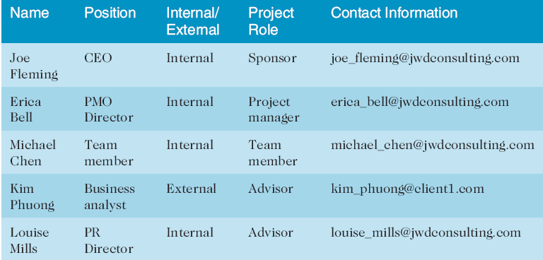
Stakeholder Register

Slide 16
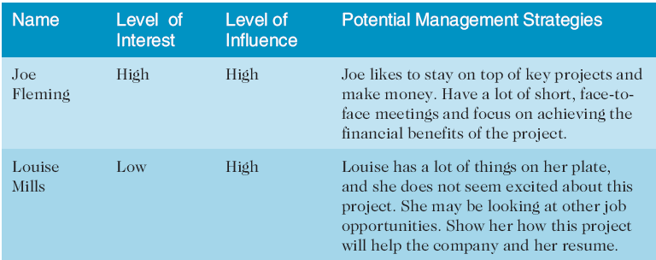
Stakeholder Management Strategy
Contents are often sensitive, so do not publish this document.

Slide 17
Project Charters and Kick-off Meetings
Project Charters are normally short and include key project information and stakeholder signatures
It’s good practice to hold a kick-off meeting at the beginning of a project:
stakeholders can meet each other
review the goals of the project
discuss future plans

Slide 18
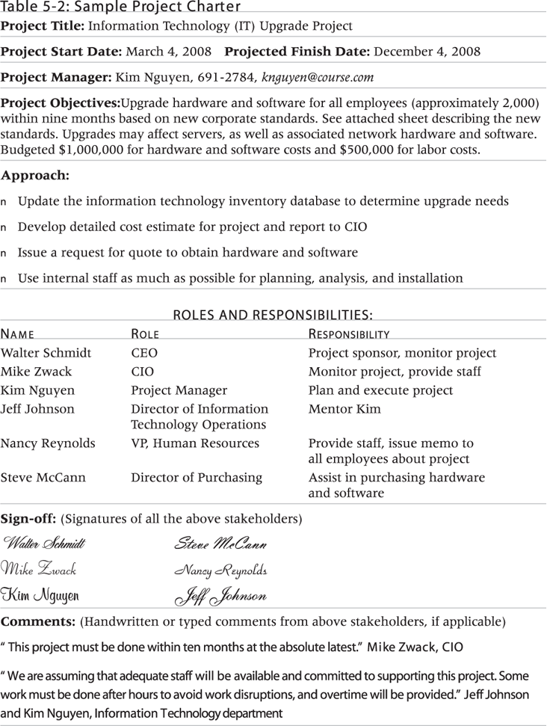
Sample Project Charter

Slide 19
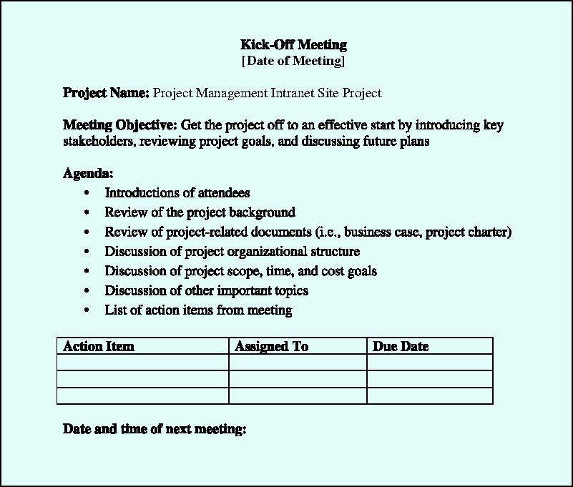
Kick-off Meeting Agenda

Slide 20
Project Planning
The main purpose of project planning is to guide execution
Every knowledge area includes planning information (see Table 3-7 on pages 97-98)
Key outputs included in a project include:
A team contract or “Team Charter”
A project scope statement
Product characteristics and requirements
Deliverable summaries
Project success and criteria in detail
A work breakdown structure (WBS) (Pg. 105)
A project schedule, in the form of a Gantt chart with all dependencies and resources (Pg. 106)
A list of prioritized risks (part of a risk register)
See sample documents on pages 100-107 or Moodle website

Slide 21
Process Group & Activity Level
See PMBOK 2008 Fig. 3.2 pg. 41

Slide 22
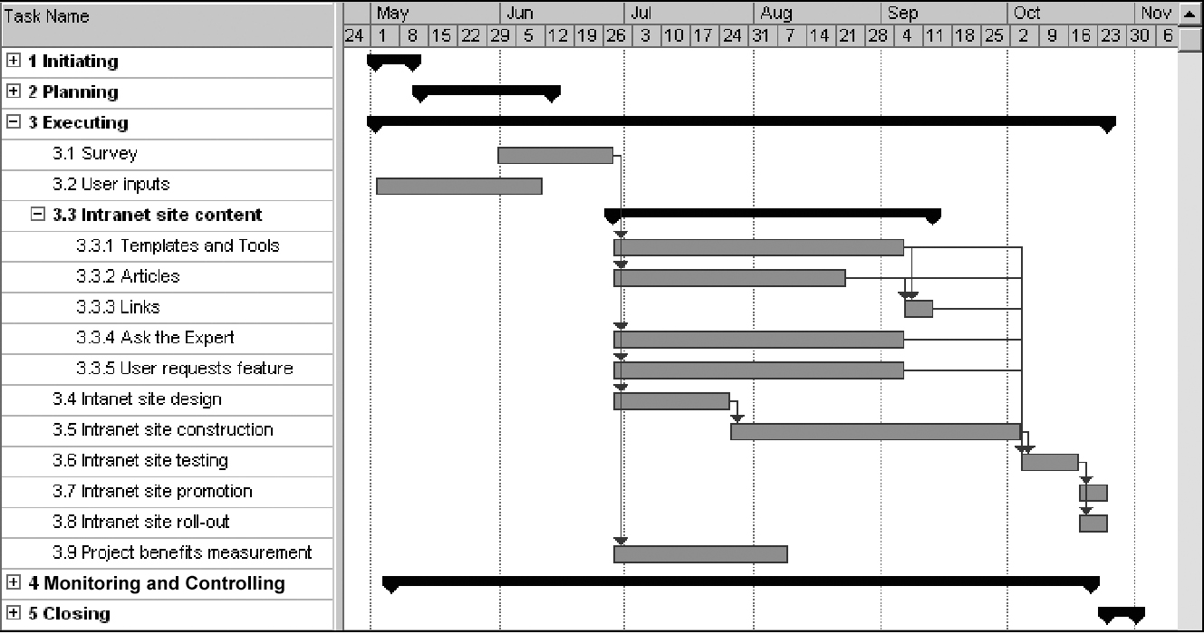
Example of an IT Gantt Chart

Slide 23
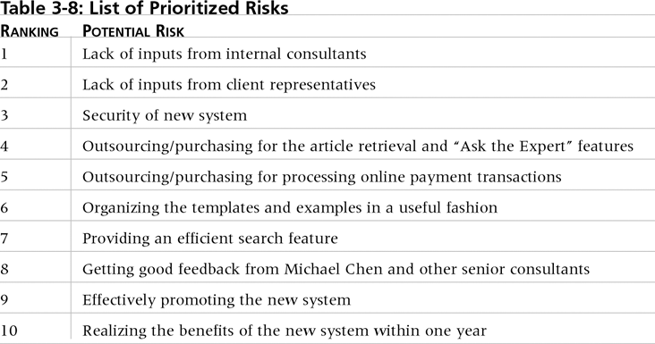
List of Prioritized Risks

Slide 24
Project Executing
Usually takes the most time and resources to perform project execution
Project managers must use their leadership skills to handle the many challenges that occur during project execution
page 57 PMBOK 2008 lists the executing processes and outputs
many project sponsors and customers focus on deliverables/outputs related to providing the products, services, or results desired from the project
A milestone report can help focus on completing major milestones (sometimes) deliverables (following slide)

Slide 25
Process Group & Activity Level

Slide 26
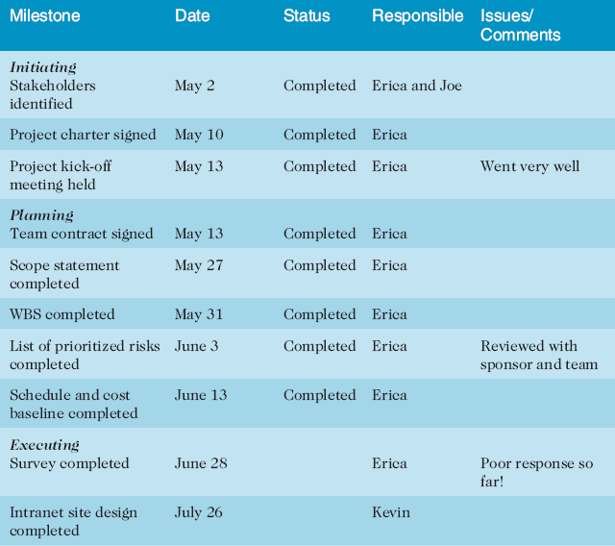
Part of a Milestone Report

Slide 27
Best Practice
One way to learn about best practices in project management is by studying recipients of PMI’s Project of the Year award
The Quartier international de Montreal (QIM), Montreal’s international district, was a 66-acre urban revitalization project in the heart of downtown Montreal
This $90 million, five-year project turned a once unpopular area into a thriving section of the city with a booming real estate market and has generated $770 million in related construction

Slide 28
Project Monitoring and Controlling
Involves measuring progress toward project objectives, monitoring deviation from the plan, and taking correction actions
Affects all other process groups and occurs during all phases of the project life cycle
Outputs include:
performance reports
change requests
updates to various plans

Slide 29
Process Group & Activity Level

Slide 30
Project Closing
Involves gaining stakeholder and customer acceptance of the final products and services
projects not completed, should also be closed to learn from the past
Outputs:
project archives
lessons learned document
Perhaps a final report and presentation to the sponsor/senior management
OAC Operational Acceptance Criteria

Slide 31
Process Group & Activity Level

Slide 32
Chapter Summary
The five project management process groups are initiating, planning, executing, monitoring and controlling, and closing
You can map the main activities of each process group to the nine knowledge areas

